Slide 1
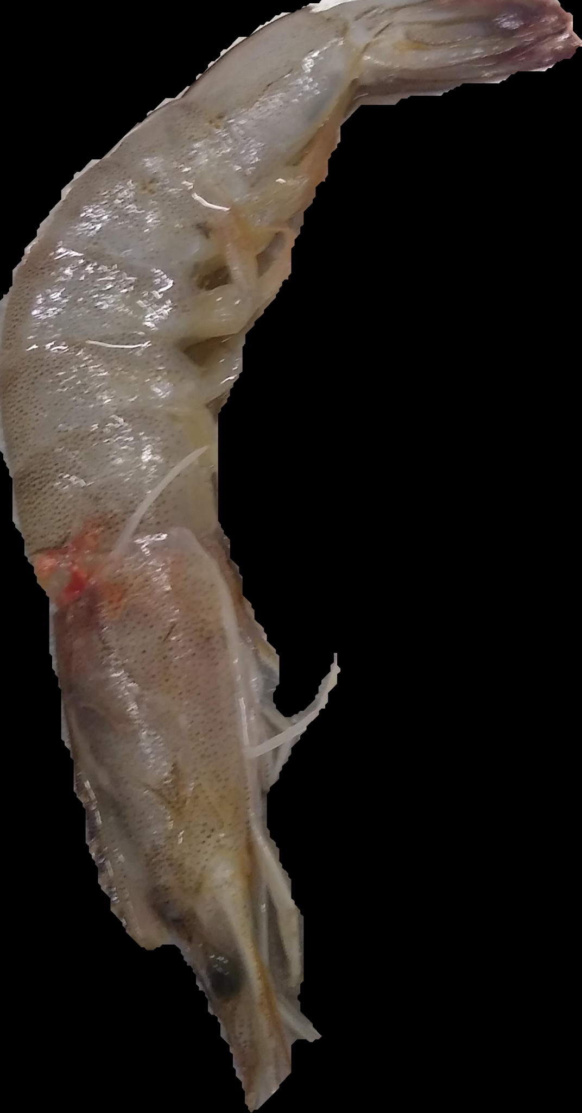
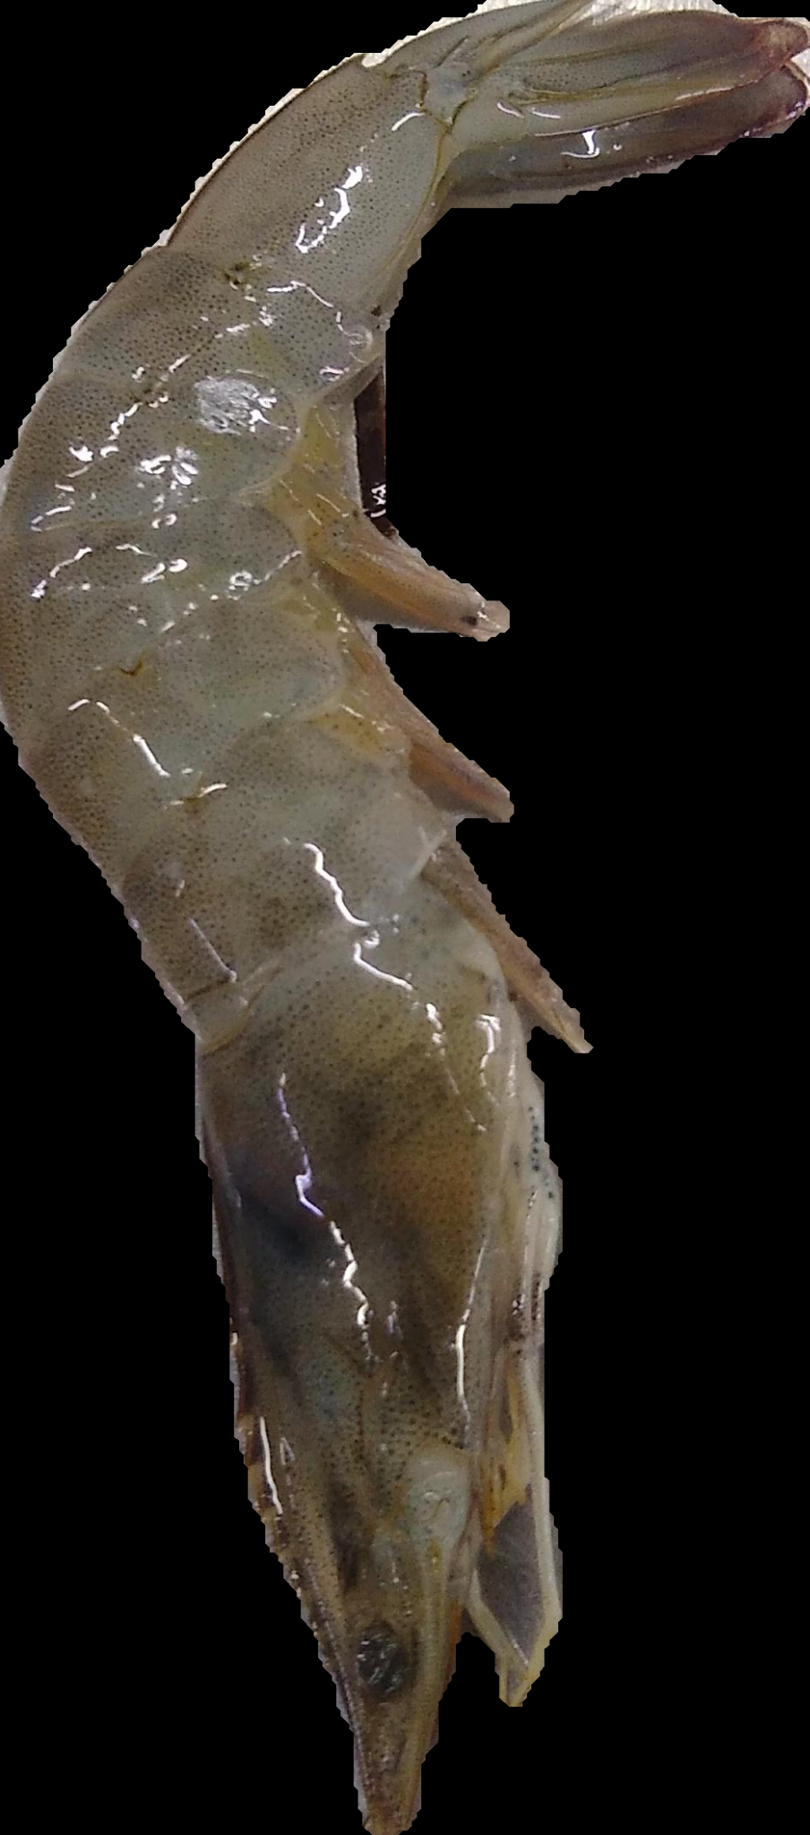
Dataset
segmented images with black bg
train : bad-921, good-920
test : bad-287, good-250
Model Architecture :
densenet121, all layers freezed,
global average pooling 2d, 140, 150, 50, softmax
batch size : 32
target size : (280, 180)
Bad
Good

Slide 2
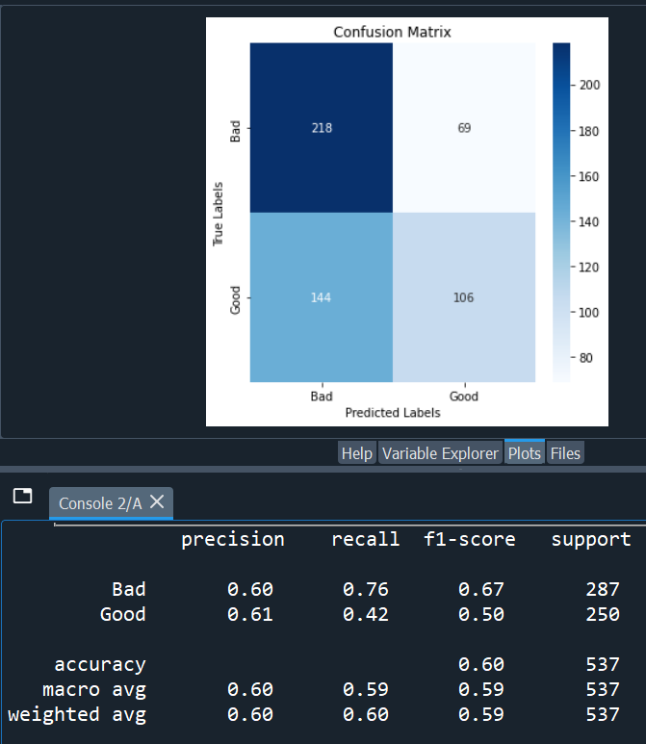
Exp1 :
model architecture :
densenet121, all layers freezed,
global average pooling 2d, 140, 150, 50, softmax
target size : (280, 180)
checkpoint : precision_1
losses : precision_1, precision_0
weights : 0.6, 0.4
epochs : 10
colorspace : RGB
batch size : 32
test acc : 60

Slide 3
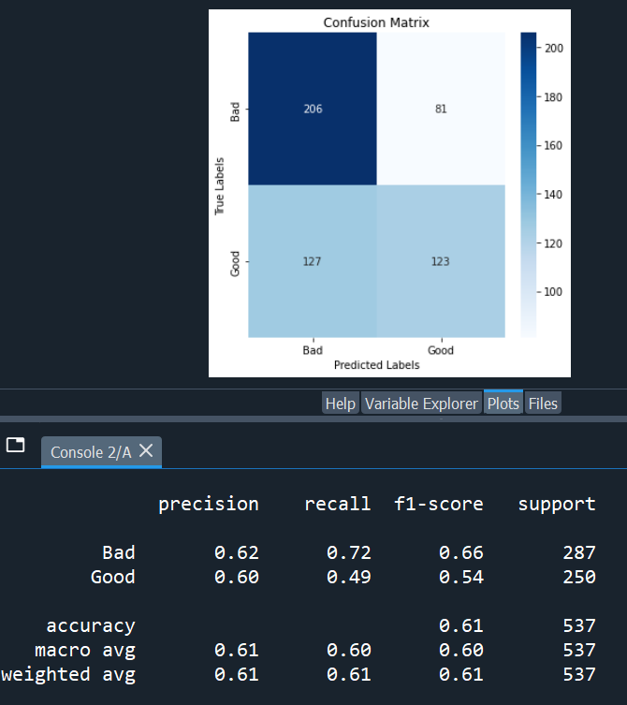
Exp2 :
model architecture :
densenet121, all layers freezed,
global average pooling 2d, 140, 150, 50, softmax
target size : (280, 180)
checkpoint : precision_0
losses : precision_1, precision_0
weights : 0.6, 0.4
epochs : 10
colorspace : RGB
batch size : 32
test acc : 61

Slide 4
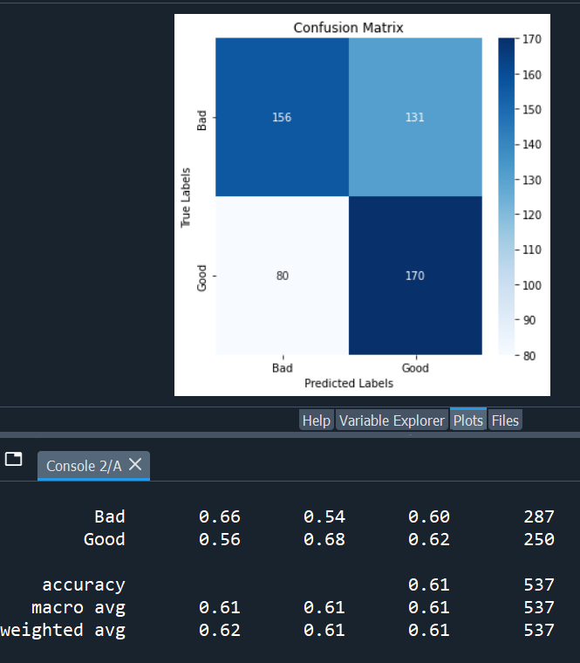
Exp3 :
model architecture :
densenet121, all layers freezed,
global average pooling 2d, 140, 150, 50, softmax
target size : (280, 180)
checkpoint : precision_0
losses : precision_1, precision_0
weights : 0.4, 0.6
epochs : 10
colorspace : RGB
batch size : 32
test acc : 61

Slide 5
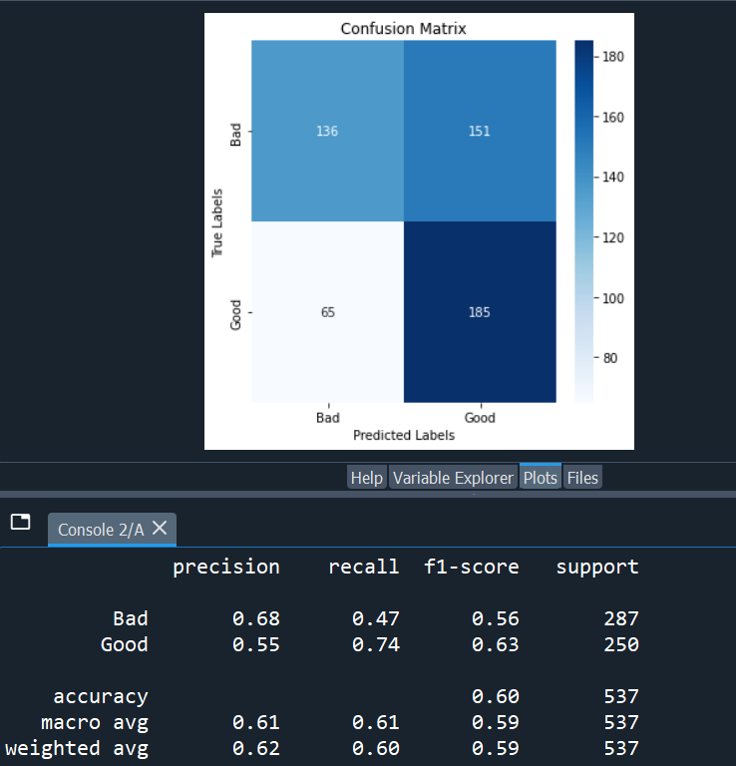
Exp4 :
model architecture :
densenet121, all layers freezed,
global average pooling 2d, 140, 150, 50, softmax
target size : (280, 180)
checkpoint : precision_0
losses : precision_1, precision_0
weights : 0.5, 0.5
epochs : 10
colorspace : RGB
batch size : 32
test acc : 60

Slide 6
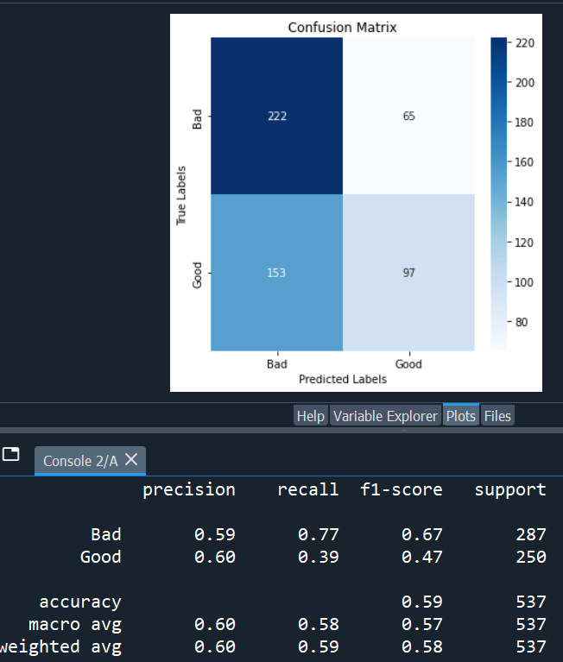
Exp5 :
model architecture :
densenet121, all layers freezed,
global average pooling 2d, 140, 150, 50, softmax
target size : (280, 180)
checkpoint : accuracy
losses : precision_1, precision_0
weights : 0.5, 0.5
epochs : 10
colorspace : RGB
batch size : 32
test acc : 59

Slide 7
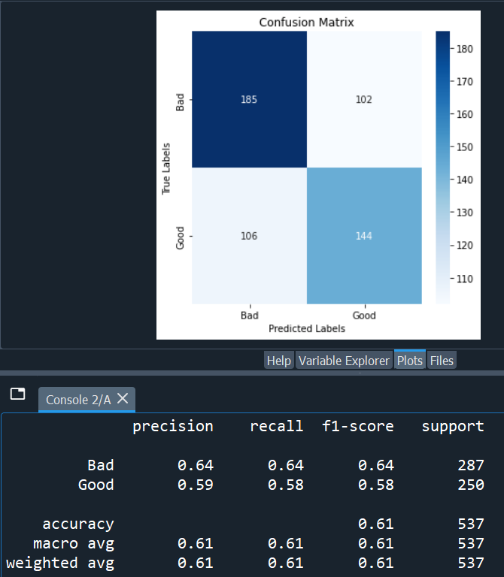
Exp6 :
model architecture :
densenet121, all layers freezed,
global average pooling 2d, 140, 150, 50, softmax
target size : (280, 180)
checkpoint : accuracy
losses : sparse_categorical_crossentropy
epochs : 10
colorspace : RGB
batch size : 32
test acc : 61

Slide 8
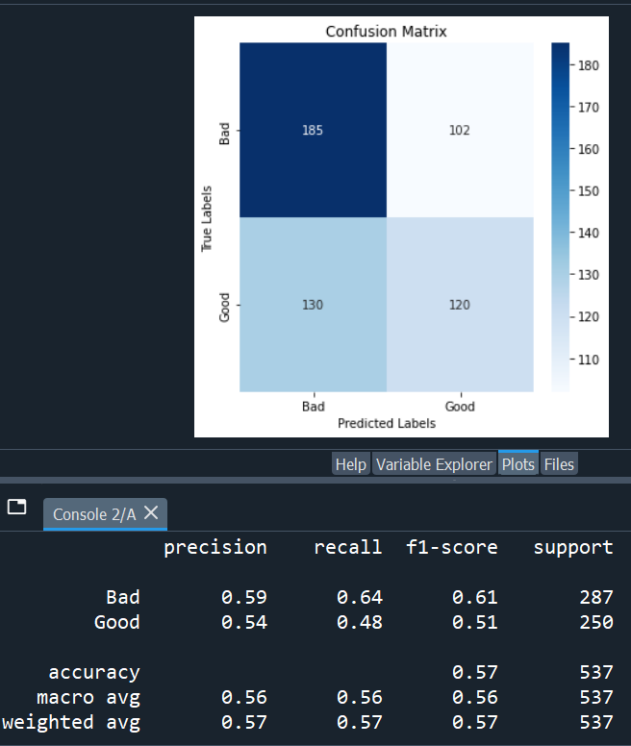
Exp7 :
model architecture :
densenet121, all layers freezed,
global average pooling 2d, 140, 150, 50, softmax
target size : (280, 180)
checkpoint : accuracy
losses : sparse_categorical_crossentropy
epochs : 10
colorspace : HSV
batch size : 32
test acc : 57

Slide 9
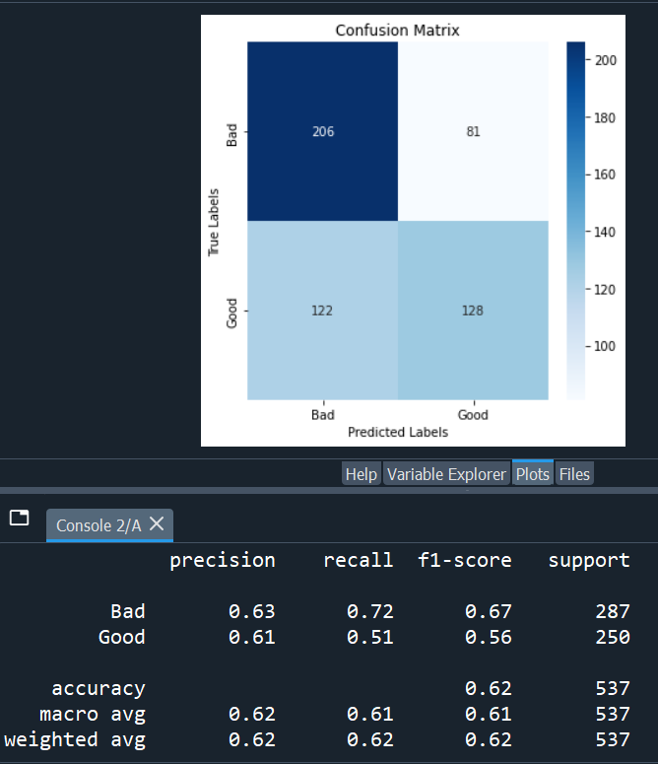
Exp8 :
model architecture :
densenet121, all layers freezed,
global average pooling 2d, 140, 150, 50, softmax
target size : (280, 180)
checkpoint : accuracy
losses : sparse_categorical_crossentropy
epochs : 10
colorspace : BGR
batch size : 32
test acc : 62

Slide 10
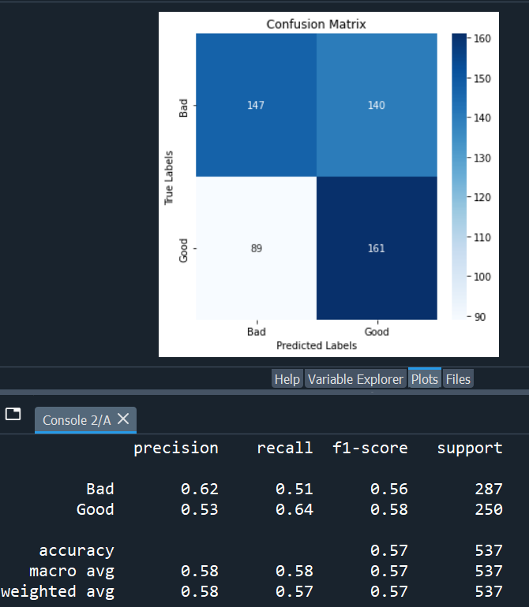
Exp9 :
model architecture :
densenet121, all layers freezed,
global average pooling 2d, 140, 150, 50, softmax
target size : (280, 180)
checkpoint : accuracy
losses : sparse_categorical_crossentropy
epochs : 20
colorspace : BGR
batch size : 32
test acc : 57

Slide 11
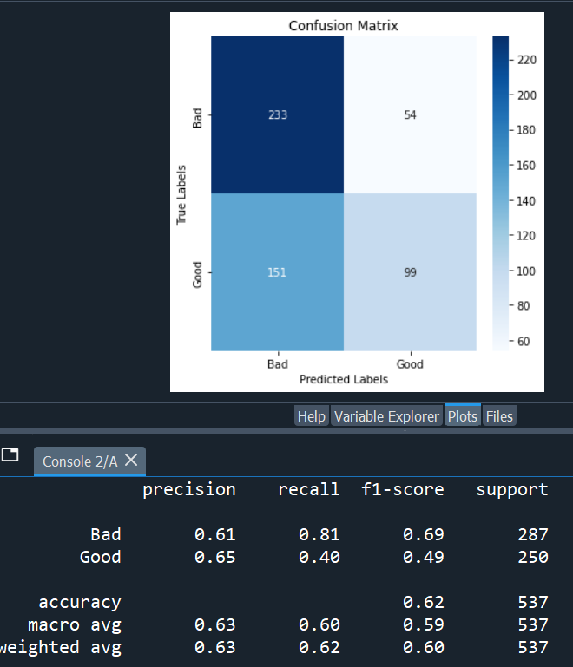
Exp10 :
model architecture :
densenet121, all layers freezed,
global average pooling 2d, 140, 150, 50, softmax
target size : (280, 180)
checkpoint : accuracy
losses : recall_0_loss
epochs : 10
colorspace : BGR
batch size : 32
test acc : 62

Slide 12
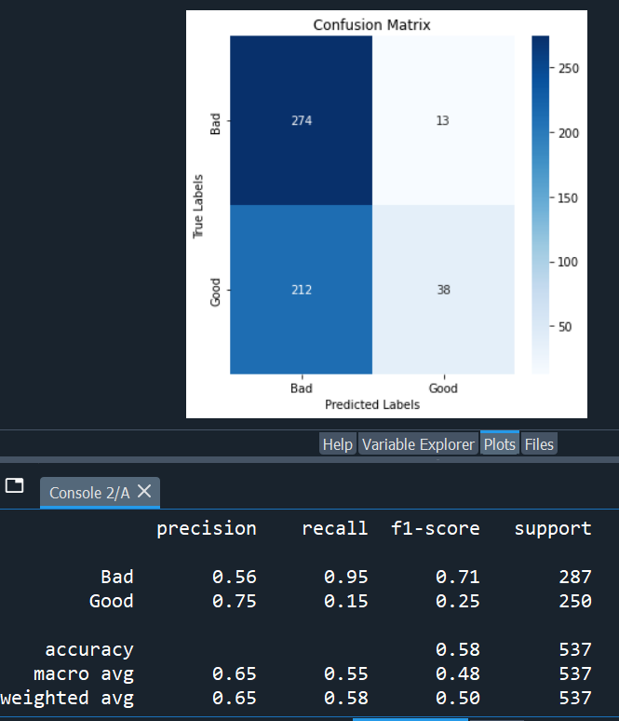
Exp11 :
model architecture :
densenet121, all layers freezed,
global average pooling 2d, 140, 150, 50, softmax
target size : (280, 180)
checkpoint : recall_1
losses : recall_0_loss
epochs : 10
colorspace : BGR
batch size : 32
test acc : 58

Slide 13
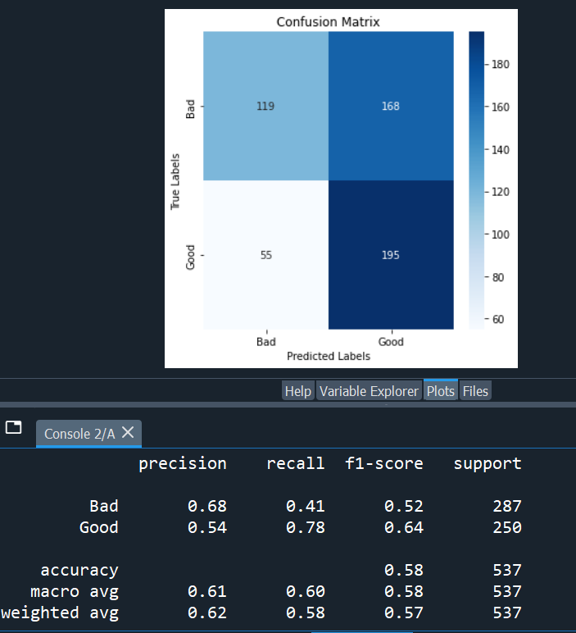
Exp12 :
model architecture :
densenet121, all layers freezed,
global average pooling 2d, 140, 150, 50, softmax
target size : (280, 180)
checkpoint : recall_1
losses : 'recall_1_loss', 'precision_1_loss'
epochs : 10
colorspace : BGR
batch size : 32
test acc : 58

Slide 14
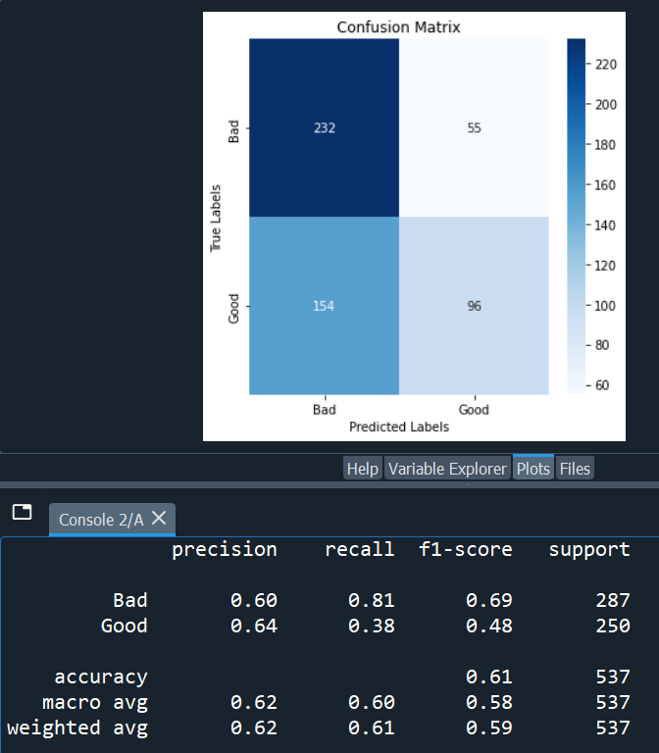
Exp13 :
model architecture :
densenet121, all layers freezed,
global average pooling 2d, 140, 150, 50, softmax
target size : (280, 180)
checkpoint : macro_avg_precision
losses : sparse_categorical_crossentropy
epochs : 10
colorspace : BGR
batch size : 32
test acc : 61

Slide 15
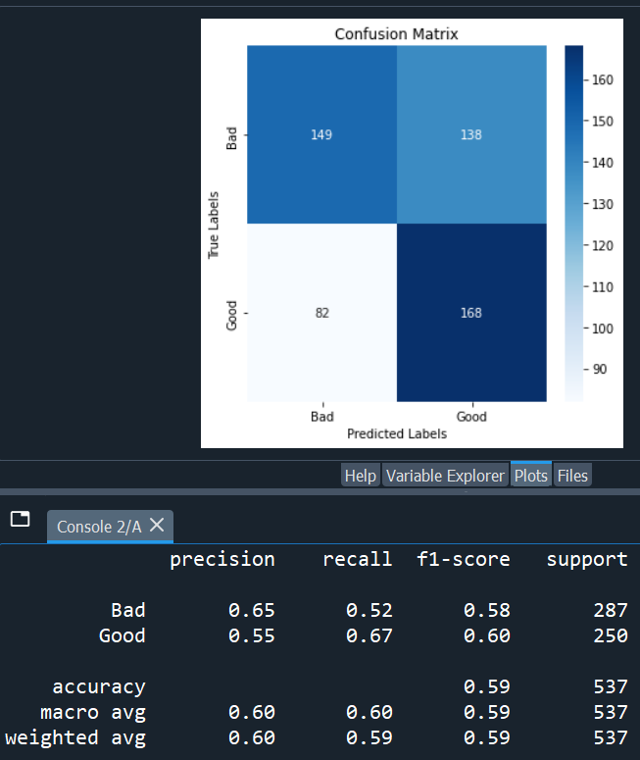
Exp14 :
model architecture :
densenet121, all layers freezed,
global average pooling 2d, 140, 150, 50, softmax
target size : (280, 180)
checkpoint : macro_avg_precision
losses : sparse_categorical_crossentropy
epochs : 20
colorspace : BGR
batch size : 32
test acc : 59

Slide 16
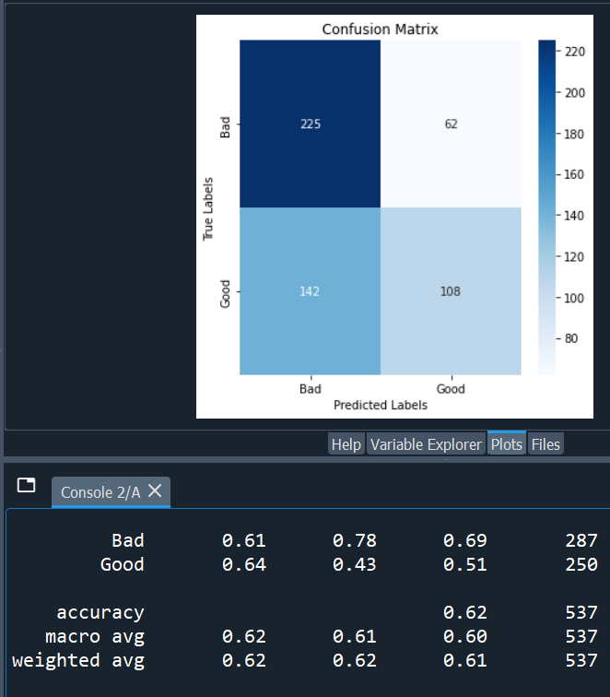
Exp15 :
model architecture :
densenet121, all layers freezed,
global average pooling 2d, 140, 150, 50, softmax
target size : (280, 180)
checkpoint : f1_score_1
losses : sparse_categorical_crossentropy
epochs : 10
colorspace : BGR
batch size : 32
test acc : 62

Slide 17
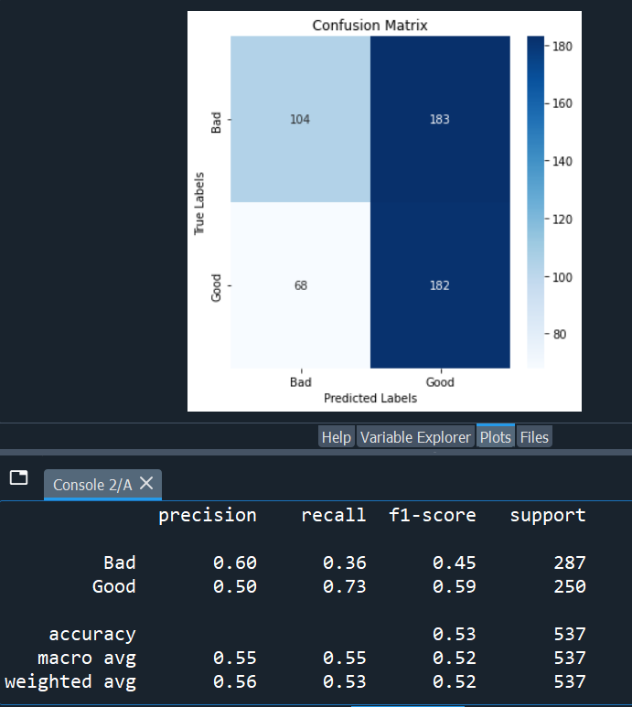
Exp16 :
model architecture :
densenet121, all layers freezed,
global average pooling 2d, 140, 150, 50, softmax
target size : (280, 180)
checkpoint : f1_score_1
losses : f1_score_1_loss
epochs : 10
colorspace : BGR
batch size : 32
test acc : 53

Slide 18
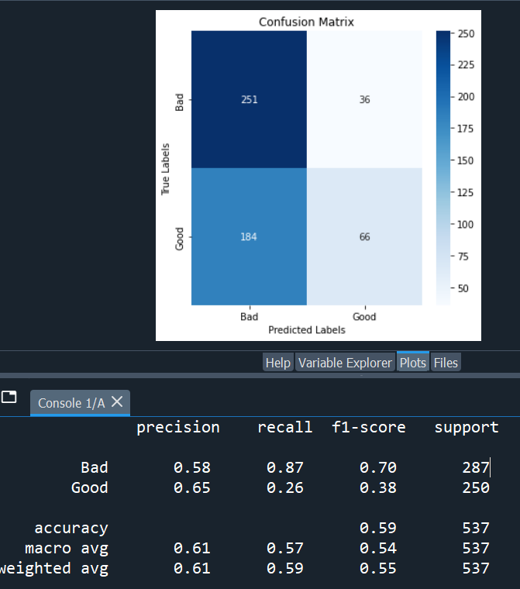
Exp17 :
model architecture :
densenet121, all layers freezed,
global average pooling 2d, 140, 150, 50, softmax
target size : (280, 180)
checkpoint : f1_score_1
losses : precision_1_loss
epochs : 10
colorspace : BGR
batch size : 32
test acc : 59

Slide 19
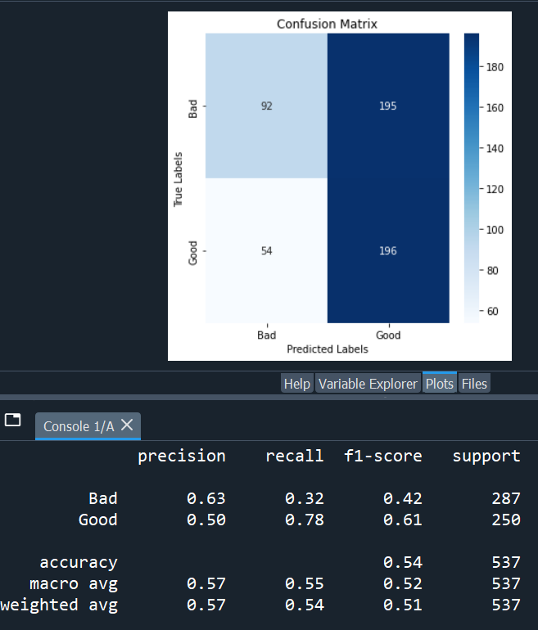
Exp18 :
model architecture :
densenet121, all layers freezed,
global average pooling 2d, 140, 150, 50, softmax
target size : (280, 180)
checkpoint : recall_1
losses : precision_1_loss
epochs : 10
colorspace : BGR
batch size : 32
test acc : 54

Slide 20

Exp19 :
model architecture :
densenet121, all layers freezed,
global average pooling 2d, 140, 150, 50, softmax
target size : (280, 180)
checkpoint : recall_1
losses : precision_1_loss
epochs : 20
colorspace : BGR
batch size : 32
test acc : 59

Slide 21
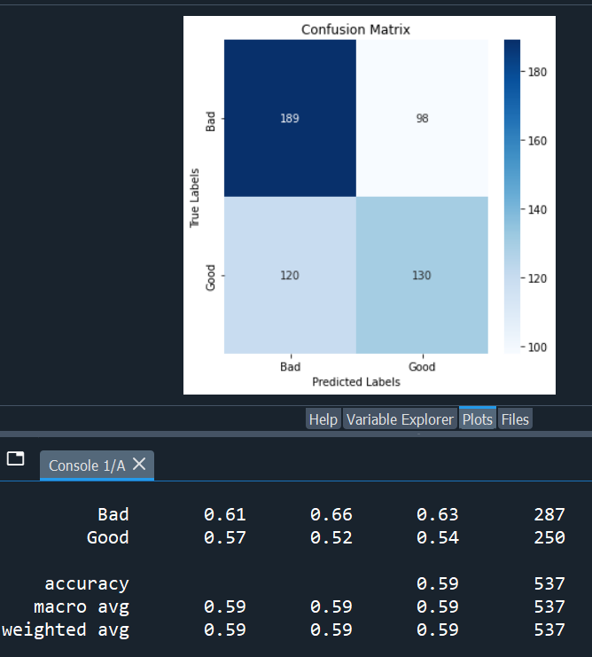
Exp20 :
model architecture :
densenet121, all layers freezed,
global average pooling 2d, 140, 150, 50, softmax
target size : (280, 180)
checkpoint : f1_score_1
losses : precision_1_loss
epochs : 20
colorspace : BGR
batch size : 32
test acc : 59

